Slide 1
Does the U.S. Presidential Election impact the Nominal Effective Exchange Rate?
AI Boot Camp Project 1
Team Members:
Patrick Nwankwo
Jesse Poljak
Larry Azar

Slide 2
Project Overview
Overview
Our project captures a comprehensive time series prediction of a Foreign Exchange (FX) model, showcasing its ability to forecast currency exchange rates with high precision and accuracy. The analysis employs historical data spanning several years from 1996 -2024, incorporating crucial geopolitical events, focusing most specifically to U.S presidential election years, and market sentiment. Utilizing advanced statistical techniques and machine learning algorithms, the model identifies patterns and trends to predict future movements in FX rates.
Foreign exchange, commonly known as FX, is the global marketplace for trading national currencies.

Slide 3
Project Overview
Goals/Questions to be addressed
Predicting the exchange rate in the upcoming 100 days that includes the before and after of the US Presidential Election
Examine any other potential seasonalities of exchange rate data
Determine whether election years produce a higher or lower exchange rate, and whether there is increased variability in the October to December timeframe

Slide 4
Project Overview
Overview of data collection, cleanup and exploration process
Data Source: Bank of International Settlements (Central Banks of 60 countries)
Data: Nominal Effective Exchange Rate (NEER), i.e. Unadjusted:
geometric trade-weighted average rate “index” of 64 bilateral exchange rates.
Can serve as measure of international competitiveness/gauge of external shocks.
Data period : 11/4/1996 to 9/24/2024 Size of Data: 10,401 rows, 12 columns.
Data used: “Date” and “NEER”
Exploratory Data: The daily performance in October and November.

Slide 5

Approach
Challenges:
Understanding our data
How will we properly isolate election impact?
Making sense of swings in different directions over time
Where do we start?

Slide 6
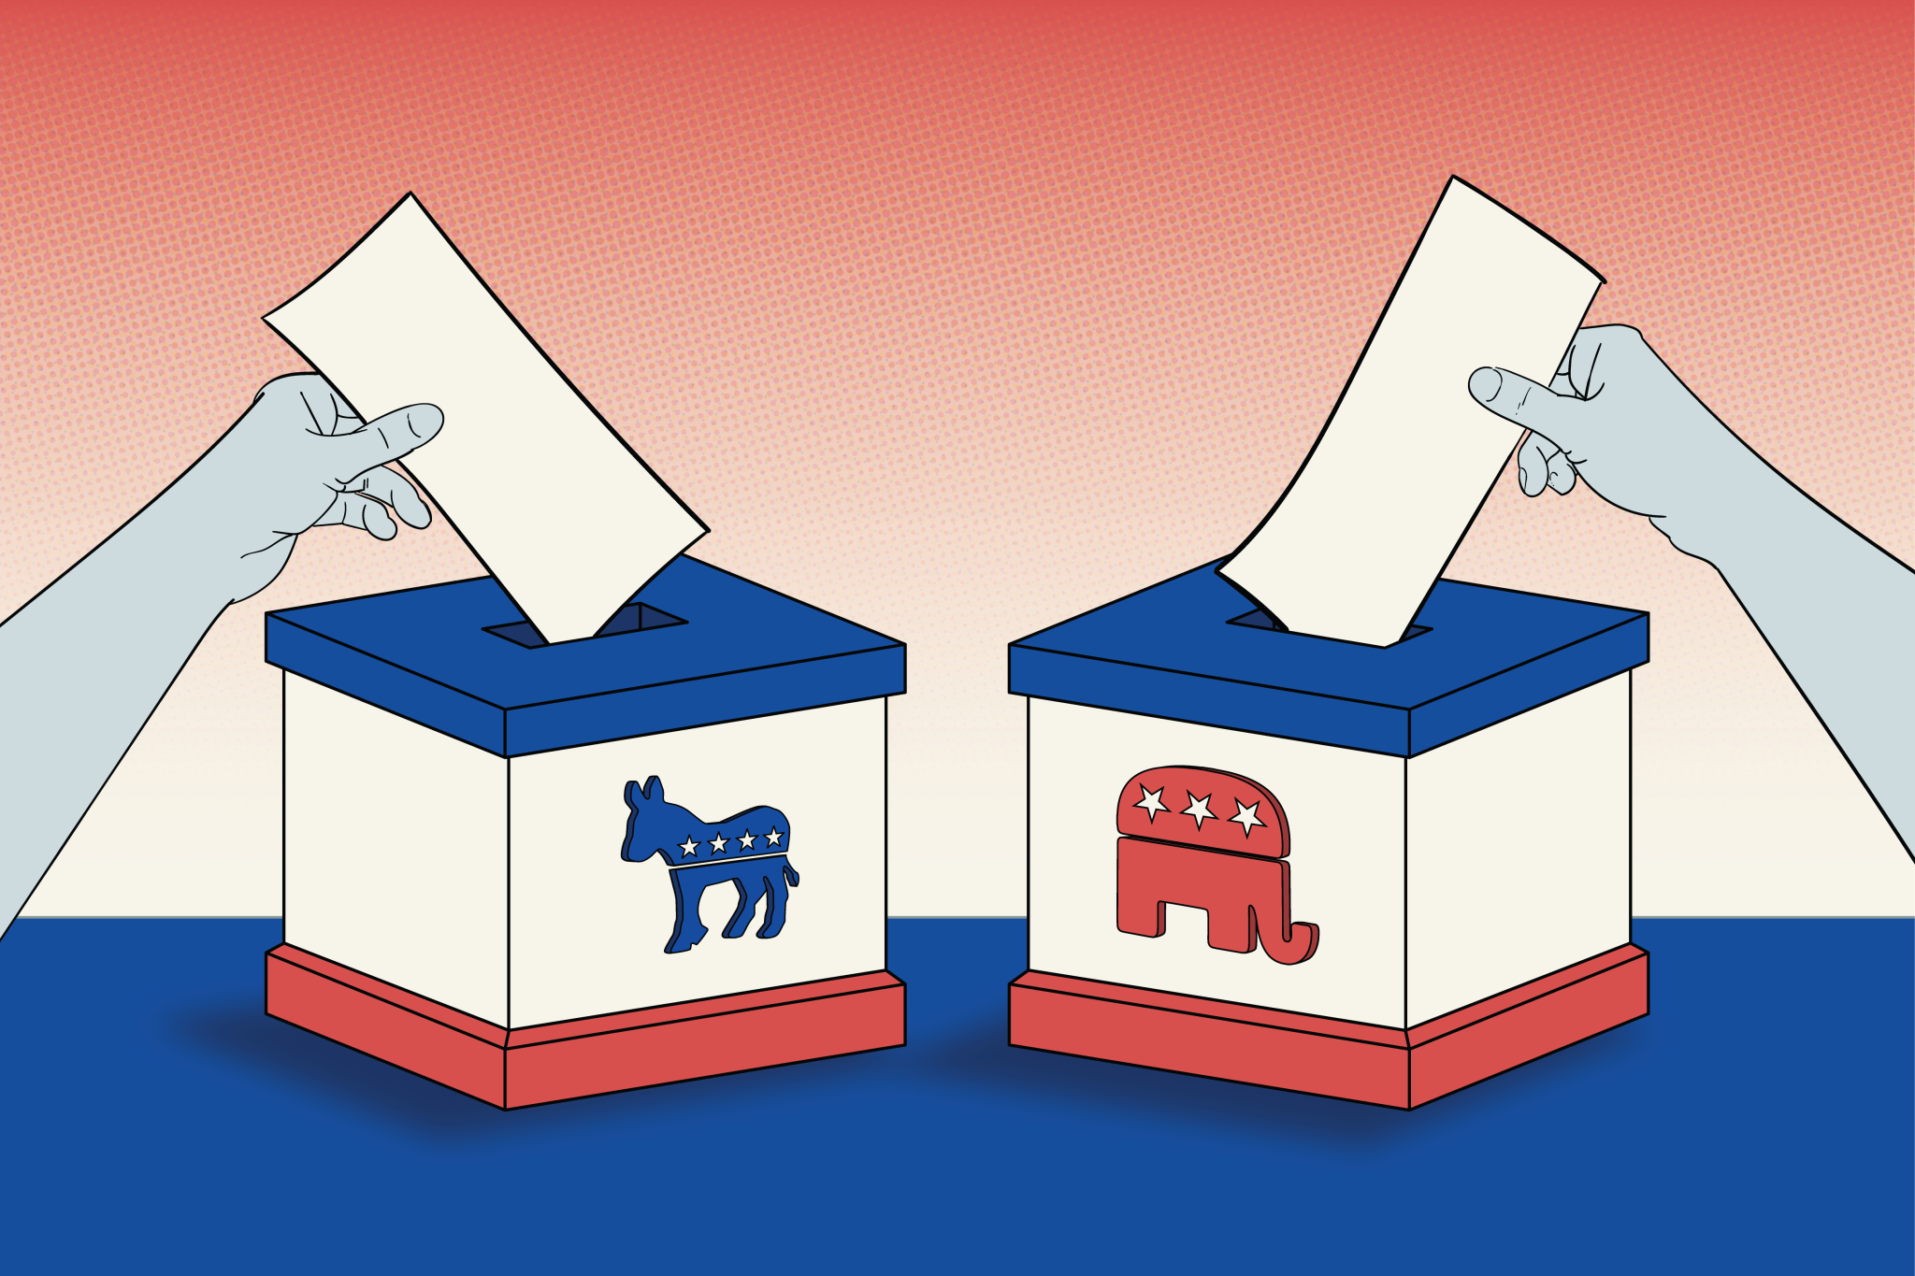
Approach
Breaking it Down:
Clean/Examine our data
Create a Prophet model to predict where the exchange rate will go next
Dive into general seasonality
Choose an Election Season timeframe
Zoom in on Election Years vs. Non Election Years

Slide 7
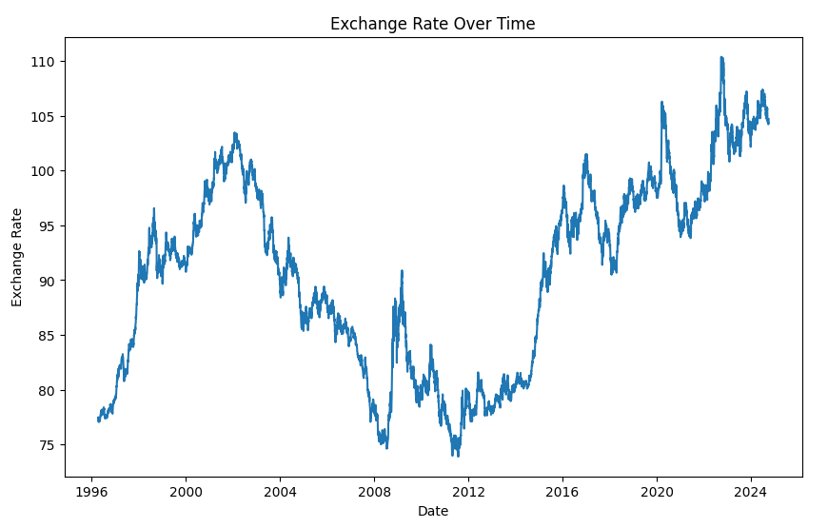
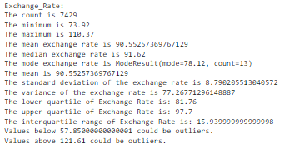
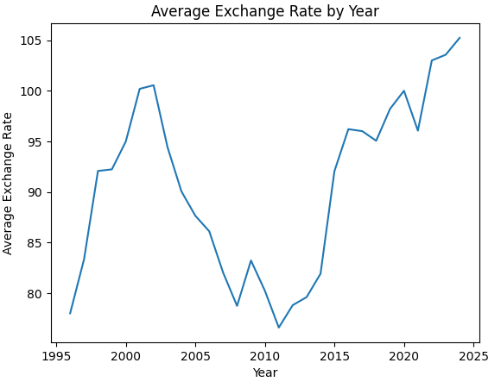
Understanding our Data

Slide 8
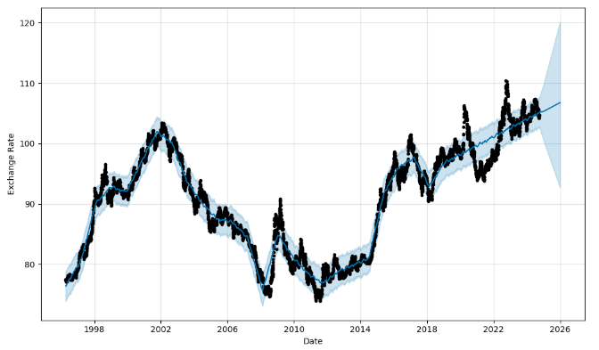
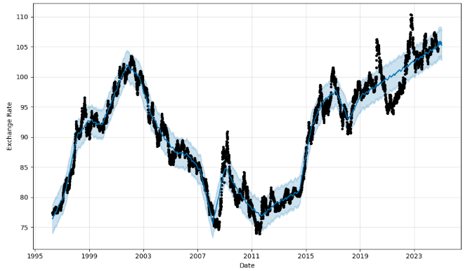
Prophet Model Predictions
2 Year Prediction
100 Day Prediction

Slide 9
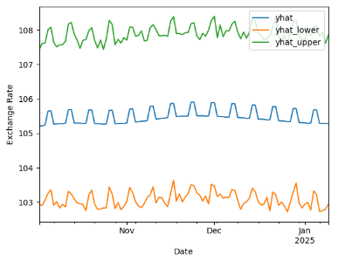
Pre and Post Election Zoom In
100 Day Prediction
Current Exchange Rate: ~104
Prediction: With 80% confidence we can say that the exchange rate will remain between 102 and 109, with the most likely outcome being between 105 and 106

Slide 10
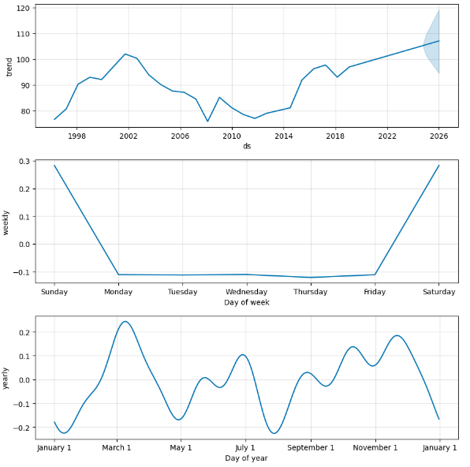

Prophet Seasonalities and Trend
Predicting a steady increase in exchange rate, but with large potential variability
Unable to glean weekly seasonality due to dataset
Minimal yearly seasonality

Slide 11
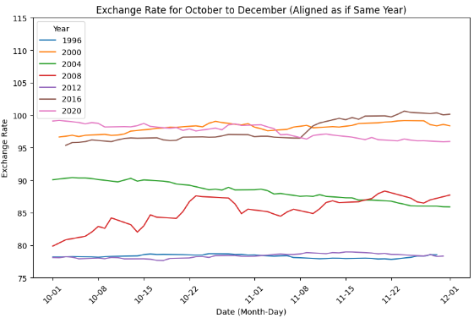
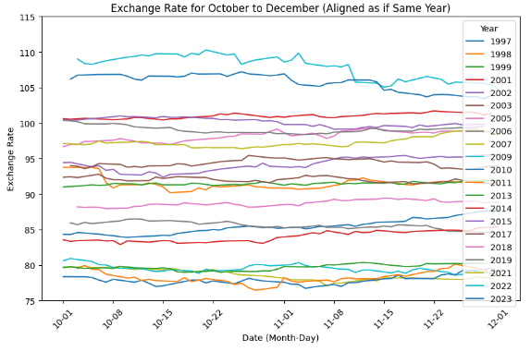
October to December Analysis

Slide 12
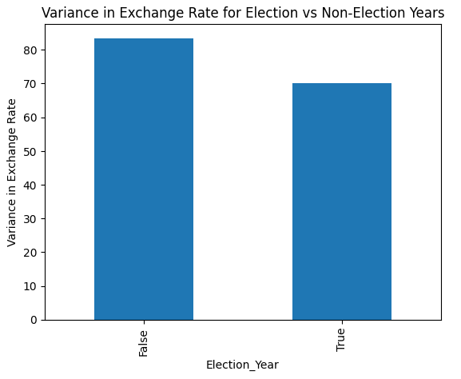
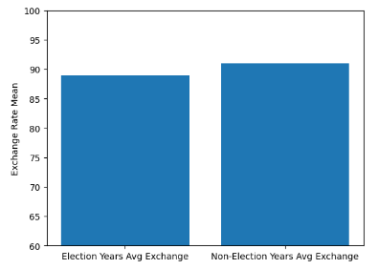
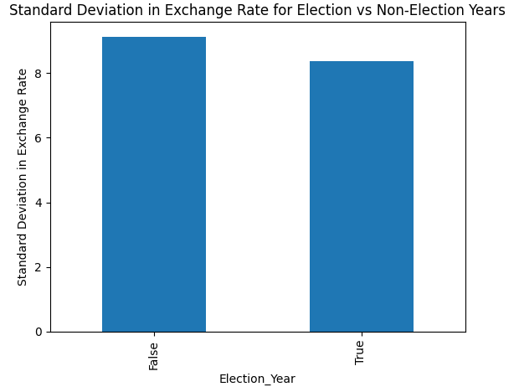
Exchange Rate Variability
October to December Analysis
Average Exchange Rate

Slide 13

Transitions of power
Which Party has the White House, House of Representatives and Senate?
Should we bring in consideration of midterm elections?
Economic Indicators: Integration of vital economic data such as interest rates, inflation rates, and GDP growth to enhance prediction reliability
Geopolitical Insights: Consideration of global political events that impact currency values, ensuring a holistic approach to FX prediction
Future Considerations

